Slide 1
7 Keys to Accelerate Profits by Partnering with Metanoia, Inc.: A Strategic Ally
Metanoia, Inc.
Critical Systems Thinking™
Metanoia, Inc.
Email: experts@metanoia-inc.com
Web: http://www.metanoia-inc.com
Phone: 1-650-641-0082
Fax: 1-650-641-0086
© Metanoia, Inc.
All Rights Reserved

Slide 2
Genesis of This Presentation
We have identified 7 canonical areas and their corresponding pain points, where operators & vendors typically need help to rapidly accelerate profits
(based on our decade+ of serving clients in the telecom ecosystem)

Slide 3
Our Purpose in this Presentation
Highlight the 7 focus areas and their corresponding pain points
Outline why these are pain points
Show how they are addressed by working with Metanoia, Inc.
  The 7 keys (ways) to accelerate profits with our partnership
Present our credentials, expertise, & experience
Showcase a sample of industry accolades received
Set context for an interactive meeting/discussion to follow

Slide 4
Outline (hyperlinked)
7 Canonical Focus Areas for Vendors and Operators, their Pain Points and Why
How Working with Us Helps Clients Address These
What We Provide to Clients to Increase Profits & Productivity
Our Expertise & Credentials and a Selection of Clients
How We Help Service Providers & Areas of Expertise Applied
Representative Carrier-Focused Projects & Activities
Where We Help Chip and System Vendors & Areas of Expertise that We Have Applied for Chip and System Vendors
Representative Vendor-Focused Projects & Activities
What Are the Benefits of Doing Business With Us?
Next Steps and A Special Invitation!
Industry Accolades from Clients/Partners

Slide 5
7 Critical Focus Areas for Operators:
Their Pain Points & Why
Back to Outline

Slide 6
7 Critical Focus Areas for Vendors:
Their Pain Points & Why
Back to Outline

Slide 7
How We Address these Pain Points …
Metanoia, Inc.
Critical Systems Thinking™

Slide 8
How Are These Addressed by
Working with Us?
At Metanoia, Inc. we provide an outstanding brain-trust that:
Accelerates client revenues & improves productivity and profits, by solving deep technical & strategic problems in the telecom space;
Delivers an outstanding client experience, by keeping client needs in our cross-hairs at all times!
Back to Outline

Slide 9
What We Provide to Our Clients to Increase Profits & Productivity
We work collaboratively to boost client initiatives via:
  Specialized conceptual knowledge (expertise, best-practices)
  Added brain power (strategic, tactical, & analytic thinking), and
  Increased horse-power (architecture & design specs)
that enables client teams (e.g. executives, architects, senior engineers, product mgt., ...) to accelerate, and accomplish critical tasks faster, better, more economically, and more enjoyably, thereby boosting profits & productivity
Back to Outline

Slide 10
Our Credentials & Clients …
Metanoia, Inc.
Critical Systems Thinking™

Slide 11
Metanoia, Inc.: Credentials & Expertise
Silicon Valley-based, celebrating nearly 15 years of success (est. 2001)
World-class, global expert network (North America, Europe, Asia)
  150+ year collective technology design, development & mgt. experience
  150+ papers; 425+ seminars; 10+ guest editorials; 25+ patents issued/pending; 50+ standards contributions (IETF, IEEE, MEF, ...); 10+ RFCs;
  Advanced graduate degrees in engineering and/or management (PhD/MS & MBAs)
    Distinguished univs. like: Univ. of California, U. of Rome, Stanford, U. Waterloo, IITs
  Worked and interacted with 50+ carriers & vendors worldwide over last 10+ years
  Synthesis of insights from diverse domains
    Wireline to wireless, Layer 1 to Layer 4, IP to optical
    Covering strategic, market/customer, and technical issues
  Accelerate product planning & strategy, product architecture & design, technology & business strategy, product development, product marketing and sales at clients
  Deep, vendor-independent, technology base
    Rock-solid record of, and reputation for, preserving client confidentiality
  360-degree perspective built from ...
    Analyzing contemporary industry practices, evolving standards, technology trends
See Client Accolades
Differentiators

Slide 12




















Analyzed Products & Solutions From ...
During the course of their work, the Metanoia, Inc. experts have dealt with a variety of products from multiple vendors in several product classes ...
Representative product classes include: multi-service systems (MSPP), Carrier Ethernet gear, Terabit routers, Broadband wireless gear, Cellular systems, Optical systems and gear, SONET/SDH equipment, metro Ethernet systems, backbone switch/routers ...
Our work has given insights into the types of networks built with such gear, and key operational issues involved
Back to Outline

Slide 13

















A Selection of Our Esteemed Clients
Metanoia, Inc. has served clients on 4 continents – North America, Europe, Asia, and Australia
Back to Outline

Slide 14
How We Help Service Providers
Metanoia, Inc.
Critical Systems Thinking™

Slide 15
How We Help Service Providers &
Areas of Expertise Applied ...

Slide 16
The Metanoia, Inc. Advantage:
Range of Experience with Operators
Metanoia, Inc.’s globally distributed network of experts has been helping service providers in these domains for over 10 years
Over the last decade+, these experts have worked with operators on business models, deep technology guidance, & network evolution:
  Pricing models
  Services definition
  System and network design and planning
  Network analysis and expert trouble-shooting
  Migration plans and technologies
  Network evolution – access, edge/metro, core, and 2G/3G to 4G/LTE, adoption of BWA technologies (WiMaX), IP/MPLS & Ethernet-based core & metro network design
  QoS – for wireline and wireless networks: techniques, principles, applications
  Security – in wireline and wireless networks
Back to Outline
Notes:
16

Slide 17
How We Contribute – Inputs We Can Provide
These are project-independent inputs that Metanoia, Inc. provide, for every project where we work with operator teams
Demonstrate the scope of problems we can solve for operators
Back to Outline
Notes:
17

Slide 18
Representative Carrier-focused
Projects & Activities
Guiding an access provider in the US on traffic engineering and dimensioning for access and metro networks. Provided key inputs on IP capabilities needed, new techniques, and best practices
Consulting to an Ethernet-only regional operator in Australia on evolving its access broadband network from a pure Layer 2 network to an IP/MPLS-based network:
  Technical evaluation of equipment capabilities, developing network migration roadmap, identifying new equipment, defining migration strategy and establishing timeline for network evolution
Advising a Tier 1 operator in the US on planning and network design for metro networks. Guidance on planning tools and their capabilities to meet the customer’s needs
Extensive analysis & comprehensive study for a European Tier 1 operator on Carrier Ethernet network design best practices, distilled from our operator experience globally

Slide 19
Representative Carrier-focused
Projects & Activities (2)
Evaluating the metro network architecture for a large wireline/wireless service provider in India; assessing network architecture and design, identifying key pain points, and making design recommendations
Consulting to a large mobile operator in India on critical PHY layer operation and network design issues to resolve significant performance problems
Network security analysis for the 3G wireless network of a mobile operator in Europe, providing guidance on anomaly detection and performance analysis
Devising Wi-Max QoS & scheduling algorithms, developing models for interaction of TCP-based apps with adaptive modulation and coding mechanisms to predict & enhance network performance
Back to Outline

Slide 20
How We Help Vendors
Metanoia, Inc.
Critical Systems Thinking™

Slide 21
Where We Help Vendors...

Slide 22
Areas of Expertise that We Have
Applied for Chip & System Vendors
Next-Generation Technology Appraisal and Applicability
  Furnish accurate analysis of evolving standards/technologies
  Facilitate strategic decisions on product roadmap
Systems Engineering -- Architecture & Design
  Validate software/hardware architectures vis-a-vis market and development timeframes
  Define, specify features and create precise engineering requirements
  Execute detailed system and/or hardware/software architecture specification in conjunction with the larger engineering teams at clients
Algorithm/protocol design & development
  Develop algorithms for specialized aspects of vendor systems
  Formulate protocols to enable unique system features

Slide 23
Areas of Expertise that We Have
Applied for Chip & System Vendors (2)
Competitive Assessment/Evaluation and Insights
  Insightful feature comparisons based on formulated benchmarks
  Intelligent evaluation of products to discern key capabilities
  Incisive market analysis to assess product standing
Component Evaluation and Selection
  Assess and evaluate components from multiple vendors (e.g traffic managers, network processors, switching cores)
  Feature-based comparisons, based on customer requirements
RFI/RFP Response Formulation and Support
  Guide formulation of precise technical responses to carrier RFI/RFPs, keeping in view system features and industry standards
Insights on New Technologies, Standards, Industry Direction
  Distill hype from reality; articulate technology benefits/drawbacks
Back to Outline

Slide 24
Representative Vendor-focused
Projects & Activities
Switching/Routing Systems
  Architect & design an IP-based control plane for hybrid packet/TDM systems for two US startups
  Analysis of system architecture of $300M+ revenue metro-core router for a Fortune 1000 client
  Design/analysis for high-performance router architectures in several initiatives
Optical Systems
  Consulted to US vendor on developing requirements for inter-domain optical routing, and on protocol extensions to realize the requirements
  Recommendations to an Asia-Pac vendor on the design, specification, and development of a generic fault notification protocol for multi-layer transport networks
  Devised specialized signaling protocols for mesh restoration in optical cross-connects
Metro/Aggregation Equipment
  Defined requirements for a next-generation Carrier Ethernet card for Fortune 1000 client
  Devised product roadmap, architecture, detailed hardware/software design, and product positioning of a Metro Ethernet access product in the South-Asia market

Slide 25
Representative Vendor-focused
Projects & Activities (2)
Semiconductor Houses
  Advised leading US semiconductor vendor on key system aspects of networking gear (high-performance switch/routers) and theory/principles behind its design & operation
  Consulted a leading FPGA vendor on incorporating advanced SONET/SDH and IP capabilities in new products, and advised on system aspects of next-gen metro access gear
Telecom Services/Technology Houses
  Advanced coaching to senior management & engineering at a leading Asia-Pac technology house on: IP VPNs, next-generation switching gear, network design principles, wireless technologies, and IP QoS
  Advised a Tier-1 software house in Asia-Pac on a variety of next-generation telecom technologies, and issues of network design/planning, and provider evolution strategies
Network Planning Tool Vendors
  Guidance on design of a distributed architecture of a network planning software tool
  Developed design rules for realizing QoS in IP-based core networks, and collaborated on Internet backbone traffic analysis
  Joint work on IP traffic eng. techniques, algorithms, protocols, carrier current practices
Back to Outline

Slide 26
Why Do Business With Us?
Metanoia, Inc.
Critical Systems Thinking™

Slide 27
Benefits of Doing Business
With Us? (1)
See Industry Accolades!
See Industry Accolades!

Slide 28
Benefits of Doing Business
With Us? (2)
See Industry Accolades!
See Industry Accolades!

Slide 29
Benefits of Doing Business
With Us? (3)
See Industry Accolades!
See Industry Accolades!

Slide 30
Next Steps …
Metanoia, Inc.
Critical Systems Thinking™

Slide 31
Next Steps and A Special Invitation!
We invite you to:
  An interactive meeting/telecon, where we will explain some of the work done for clients worldwide, and help you see what problems we can solve for you to boost profits and productivity
  Utilize the exclusive Strategy Session Certificate ahead to interact with the Metanoia, Inc. team, and brainstorm an issue or a relevant problem to experience the caliber, competence, and capability of the team!

Slide 32
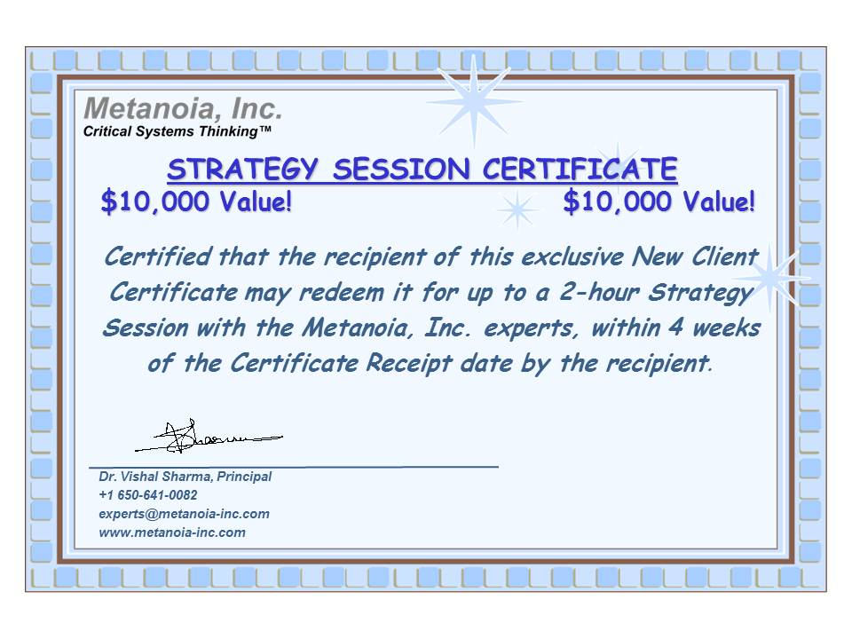
An Exclusive Gift!
Back to Outline

Slide 33
Accolades from the Industry ...
Metanoia, Inc.
Critical Systems Thinking™

Slide 34
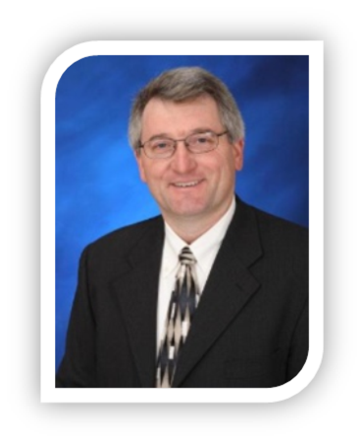

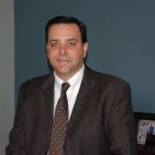
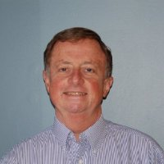
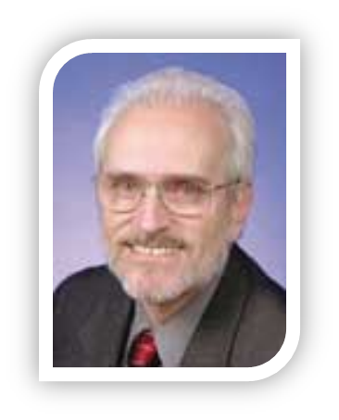
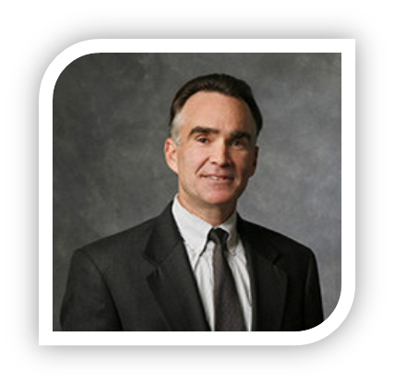
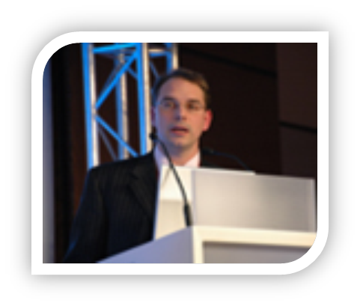
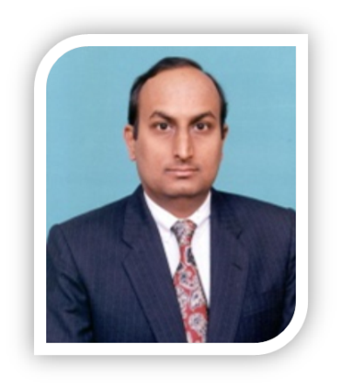
Hear Directly What Some of Our
Past Clients/Partners Have Said …
Please visit http://www.metanoia-inc.com and watch the video introduction
Jim Burnham, CEO
CTS Telecom
Tim Flood, VP Engg, Raydiance
Jose Enciso, Director Systems Engg, Tellabs
Marty Fielen, VP Marketing,
CTS Telecom (retd.)
Dan Morris, VP & GM (retd), Cypress
Kevin Pope, SVP Product Dvp, Calix
Tom Nadeau, VP & Principle Architect, CA
Kumar Sivarajan, CTO & Founder, Tejas Networks

Slide 35

Accolades from Industry: Teamwork, Savviness, Address Challenges, ...
“Absolutely stood out, and frankly I haven’t seen it work that well in any other scenario. And that was important to me because I had some reluctance early on in terms of handing this via a consulting arrangement; cause this could evolve into a key part of our family jewels, and a key differentiator for the company and the product, and part of the discussion we had internally was how is this going to flesh out?
Are we going to be doing this onsite here working closely with the team, or is this going to be somebody offsite we never see, throwing things over the wall? … I think one of the key differentiators for Metanoia, Inc. was that you absolutely became part of the team. It was just seamless ... you worked very well from an interpersonal perspective with the team, as well as from a technology perspective.
I think it was very crisply run as a project, and I think that's a differentiator as well, because you don't normally get that when you're talking about a key area of deep-dive technology that you're looking to bring into an existing product. You might find some strong technical people, but they don't have the savviness and the sensitivity to timeframes, and planning, and looking at dependencies [that you did], and I think that was a key differentiator as well. That went very well in terms of providing us ... with a timeline as to how this was going to unfold, and then executing to that timeline”
Kevin Pope, SVP Product Development, Calix Networks (on working with Metanoia, Inc. at a previous co.)

Slide 36


Accolades from Industry: Teamwork, Savviness, Address Challenges, ...
“
“… deep knowledge of networking devices and switching architectures … pleasant to work with and very responsive” Eyal Dagan, CEO, Dune Networks, Israel
“…demonstrated an extraordinary capability to take on technically challenging tasks, and always delivered the results on time and schedule … work [on the project] led to the filing of a few technical patents for the company … highly recommend [your] consulting service to any institution …” Dr. Charles Chen, Vice-President of Software Engineering & Fellow, Cortina Systems (on working with Metanoia, Inc. at a previous company)

Slide 37


Accolades from Industry: Insight,
Knowledge, Skills, ...
“I think it says a lot when someone like an equipment vendor engages with a third party for product assessment, and then later has an interest in presenting you to our [carrier] customers as an independent reference and resource that they can engage with. And that clearly would not have occurred if we didn't have the highest regard for the integrity that you approached us with … In all of those cases, I recall stepping away with a high-level of confidence that you had navigated a fairly difficult engagement ...” Tim Flood, VP of Engineering & Operations, Red Condor (on working with Metanoia, Inc. at a previous company)
“ … very active in both academic societies like IEEE ComSoc and standard bodies like IETF …knowledge of telecommunications technologies are deep and comprehensive, and span the gamut: MPLS, GMPLS, traffic engineering, VPNs, wired and wireless networking, IP QoS,” Dr. Kohei Shiomoto, Group Leader & Supervisor, NTT Japan
“… brilliant educator ... good insights into the direction of the Telcommunications Industry at large … would highly recommend …” Dr. Rajesh Krishnaswamy, Senior Network Consultant, Reliance Infocomm, India

Slide 38


Accolades from Industry: Efficient Process, Innovations, Unique Depth ...
“I am impressed with the ability of your team to work with the members of our organization, who had their day jobs ... [yet] you were able to point questions, paint scenarios, sit down, grab a couple of hours here and there ... and extract the information, and piece it together ... so the process you used, in a very complex situation, I think was very efficient. You ran to a 100%, even if some of it was not on the clock, and I think that’s an incredible testament to the integrity that you bring ... I’ve built a confidence, if I’m going to engage Metanoia, Inc. what needs to be done will be executed, and, in large parts, will be exceeded certainly. So, I would definitely recommend you ... because you have got system-level knowledge and network-level, network-wide knowledge ... and I think you would get them [clients] to an end-solution faster” Jose Enciso, Director, Systems Engineering & Product Planning, Tellabs
“ … done a great deal of innovative work on the design and operation of high-speed networks and switching systems … one of the very few [experts] in this field that know very well both the architectural and the opto-electronic technology issues, as well as the protocol issues that arise when devices are put together in a network …” Dr. Manos Varvarigos, Director, Network Technologies Center, Computer Technology Institute, Greece
“What you do is fairly unique … Your level of engagement, I can't say that I actually have [seen it elsewhere], where what you offer are services that are very technical and capable of doing very technical, in depth, investigative exercises, which are very difficult to get, in my prior experience, very difficult to get someone that really put in the effort to learn the ins and outs. Tim Flood, Vice President, Raydiance, Inc. (on working with Metanoia, Inc. at a previous co.)

Slide 39


Accolades from Industry: Vision,
Simplify the Complex, Integrity
Your services, I would recommend, yes, based on your wonderful and technically deep inputs for the MPLS World Congress the past 12 years. If someone needs an advisor ... to figure out what the are Internet pieces, what is the strategy to follow, what are the choices to be made, I think you [Metanoia, Inc.] would definitely be up for it! Your vision of networking technology evolution, technical savoir-faire, and reliability and quick responses are key to that. As is your ability to establish good relationships, which leads to long-term collaboration like ours. Remi Scavenius, Founder, Upperside, France (organizer world-leading MPLS & Ethernet World Congress)
“I work with Wi-Max based systems daily, and would say these gentlemen have an excellent ability to convey the complex nature of Wi-Max in a simplified and concise manner ...” Ian M. McLeod, Senior Systems Engineer, Harris-Stratex Networks (now Aviat Networks)
“There is a need on the service provider side to be looking out towards systems and software to understand how the “beast” (the network) works, similarly those who are looking towards the service providers need that perspective which Metanoia, Inc. provides very well. Three qualities that come to mind when I think of Metanoia, Inc. are: technical savvy, deep market knowledge, and the integrity to call things as they are.” Arman Maghbouleh, President, Cariden Technologies
Back to Outline

Slide 40

Metanoia, Inc.: Transformational, Significant Business Impact
“My overall impression and my teams overall impression was that it was an absolutely very worthwhile exercise and I really and truly believe that this is just kind of a start. I think that we will have lots more opportunities to bring you in again for reconfirmation of some of the decisions that we have made, but I can see this really transforming our company over the next three years.
As I have gone back through the materials several times, I really like how you have kept this thing fairly simple. I mean there’s only five or six things that we really need to work on, even though those are very complex issues and each one of them is going to take a lot of time. It’s still doable … and right out of the gate we are able to implement some changes that have a significant impact on how we are doing business…and are going to do business… Jim Burnham, Chief Executive Officer

